Slide 1
Copyright Reserved: All lecture notes and related materials are solely used for this course. Please do not upload the materials to any unauthorized websites or distribute to other parties without my permission.

Slide 2
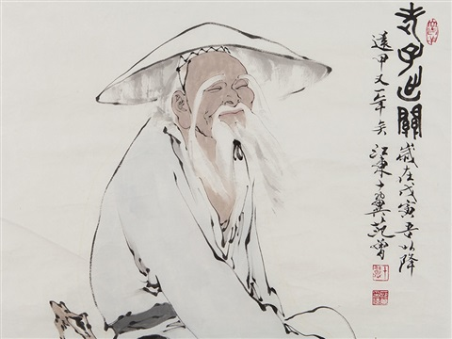
Topic 10-1 Taoism/Daoism
Laozi / Lao Tzu (600 BC.)
Book: Tao Te Ching (81 chapters, with about 5000 words)

Slide 3
Ancient Classics
Confucianism (Yin-Yang in the Book of Changes, Propriety in the Book of Rites, Confucius thoughts in the Analects, Mencius)
School of Military (The Art of War by Sun Tzu)
Legalism (Hanfeizi: Law, Tact and Position)
Daoism (Laozi: The meaning of Tao)

Slide 4
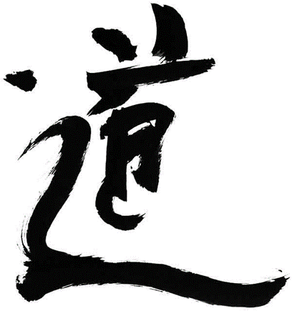
Wuwei (Inaction/Non-action) Kellerman, 2010
Difficult to decipher! And open to interpretation
Applies to doing nothing, a notion which is unthinkable in the West
Needleman interprets Tao with four layers:
Metaphysical – it describes the way things are
Psychological – it interprets human nature
Ethical – It tells us what we ought to know about how to treat each other
Spiritual – It guides us in our search for truth
Inaction: Doing nothing, achieving everything?
Misunderstanding?

Slide 5

Barbara Kellerman (2010)
Comments on Confucius Analects (pp. 14-16)
Kellerman, B. (2010). Leadership: Essential Selections on Power, Authority and Influences. NY: McGraw Hill.

Slide 6
Chapter 2
不違反事物自然规律
Not to violate the laws of nature
(let nature takes its course)
天下皆知美之為美，斯惡已。皆知善之為善，斯不善已。故有無相生，難易相成，長短相較，高下相傾，音聲相和，前後相隨。是以聖人處無為之事，行不言之教；萬物作焉而不辭，生而不有。為而不恃，功成而弗居。夫唯弗居，是以不去。
All in the world know the beauty of the beautiful, and in doing this they have (the idea of) what ugliness is; they all know the skill of the skillful, and in doing this they have (the idea of) what the want of skill is. So it is that existence and non-existence give birth the one to (the idea of) the other; that difficulty and ease produce the one (the idea of) the other; that length and shortness fashion out the one the figure of the other; that (the ideas of) height and lowness arise from the contrast of the one with the other; that the musical notes and tones become harmonious through the relation of one with another; and that being before and behind give the idea of one following another. Therefore the sage manages affairs without doing anything, and conveys his instructions without the use of speech. All things spring up, and there is not one which declines to show itself; they grow, and there is no claim made for their ownership; they go through their processes, and there is no expectation (of a reward for the results). The work is accomplished, and there is no resting in it (as an achievement). The work is done, but how no one can see; This is that makes the power not cease to be.
About Inaction (Non-action)

Slide 7
Chapter 1
道可道，非常道。名可名，非常名。無名天地之始；有名萬物之母。故常無欲，以觀其妙；常有欲，以觀其徼。此兩者，同出而異名，同謂之玄。玄之又玄，衆妙之門。
The Tao that can be trodden is not the enduring and unchanging Tao. The name that can be named is not the enduring and unchanging name. (Conceived of as) having no name, it is the Originator of heaven and earth; (conceived of as) having a name, it is the Mother of all things. Always without desire we must be found, If its deep mystery we would sound; But if desire always within us be, Its outer fringe is all that we shall see. Under these two aspects, it is really the same; but as development takes place, it receives the different names. Together we call them the Mystery. Where the Mystery is the deepest is the gate of all that is subtle and wonderful.
The Meaning of Tao

Slide 8
Chapter 23
希言自然，故飄風不終朝，驟雨不終日。孰為此者？天地。天地尚不能久，而況於人乎？故從事於道者，道者，同於道；德者，同於德；失者，同於失。同於道者，道亦樂得之；同於德者，德亦樂得之；同於失者，失亦樂得之。信不足，焉有不信焉。
Abstaining from speech marks him who is obeying the spontaneity of his nature. A violent wind does not last for a whole morning; a sudden rain does not last for the whole day. To whom is it that these (two) things are owing? To Heaven and Earth. If Heaven and Earth cannot make such (spasmodic) acting last long, how much less can man! Therefore when one is making the Tao his business, those who are also pursuing it, agree with him in it, and those who are making the manifestation of its course their object agree with him in that; while even those who are failing in both these things agree with him where they fail. Hence, those with whom he agrees as to the Tao have the happiness of attaining to it; those with whom he agrees as to its manifestation have the happiness of attaining to it; and those with whom he agrees in their failure have also the happiness of attaining (to the Tao). (But) when there is not faith sufficient (on his part), a want of faith (in him) ensues (on the part of the others).
About Nature

Slide 9
Chapter 42
道生一，一生二，二生三，三生萬物。萬物負陰而抱陽，沖氣以為和。人之所惡，唯孤、寡、不穀，而王公以為稱。故物或損之而益，或益之而損。人之所教，我亦教之。強梁者不得其死，吾將以為教父。
The Tao produced One; One produced Two; Two produced Three; Three produced All things. All things leave behind them the Obscurity (out of which they have come), and go forward to embrace the Brightness (into which they have emerged), while they are harmonized by the Breath of Vacancy. What men dislike is to be orphans, to have little virtue, to be as carriages without naves; and yet these are the designations which kings and princes use for themselves. So it is that some things are increased by being diminished, and others are diminished by being increased. What other men (thus) teach, I also teach. The violent and strong do not die their natural death. I will make this the basis of my teaching.
About Harmony
(affected by Yin-Yang)

Slide 10
Chapters 76 & 78
人之生也柔弱，其死也堅強。萬物草木之生也柔脆，其死也枯槁。故堅強者死之徒，柔弱者生之徒。是以兵強則不勝，木強則共。強大處下，柔弱處上。
天下莫柔弱於水，而攻堅強者莫之能勝，其無以易之。弱之勝強，柔之勝剛，天下莫不知，莫能行。是以聖人云：受國之垢，是謂社稷主；受國不祥，是謂天下王。正言若反。
Man at his birth is supple and weak; at his death, firm and strong. (So it is with) all things. Trees and plants, in their early growth, are soft and brittle; at their death, dry and withered. Thus it is that firmness and strength are the concomitants of death; softness and weakness, the concomitants of life. Therefore the place of what is firm and strong is below, and that of what is soft and weak is above.
***
There is nothing in the world more soft and weak than water, and yet for attacking things that are firm and strong…
Every one in the world knows that the soft overcomes the hard, and the weak the strong, but no one is able to carry it out in practice.
Weak > Strong

Slide 11
The best practice in management and governance!
In most Asian countries, the Government (‘State’) has been a major player in their Development.
→ Conglomerates (Week 11)

Slide 12
References
Tao Te Ching by Lao Tzu (translated by J. Legge). (n.d.). Retrieved from https://www.sacred-texts.com/tao/taote.htm
Dao De Ching Chinese and English versions (translated by J. Legge). (n.d.). Retrieved from https://ctext.org/dao-de-jing

